Slide 1
Noninvasive 3D Imaging and Characterization of Permafrost Profiles Using iFROST MAPPER
Rui Liu, Daniel Offenbacker, Ph.D., Cheng Zhu, Ph.D.,
Jim Kang, John Schmalzel, Ph.D., Shreekanth Mandayam, Ph.D., Ayman Ali, Ph.D., and Yusuf Mehta, Ph.D.

Slide 2
Acknowledgment
CRREL
Benjamin Barrowes, Ph.D.
Danney Glaser
Wade Lein, Ph.D.
Rowan Engineering Clinic Team
Chris Haugland (CEE)
Ryan Gordon (CEE)
Tom Vadeika (CEE)
David Sheppard (ECE)

Slide 3
Outline
Problem Statement and Background
Study Objectives
Study Benefits
Research Plan
Research Progress
Project Timeline
References

Slide 4
Outline
Problem Statement and Background
Study Objectives
Study Benefits
Research Plan
Research Progress
Project Timeline
References

Slide 5
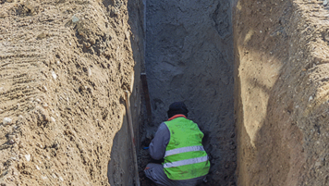
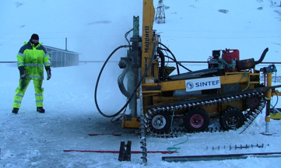
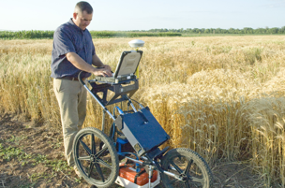
Problem Statement
The characterization of permafrost is critical to infrastructure construction in cold regions.
Most existing soil inspection techniques are high-cost, labor-intensive, destructive, or inaccurate.

Slide 6
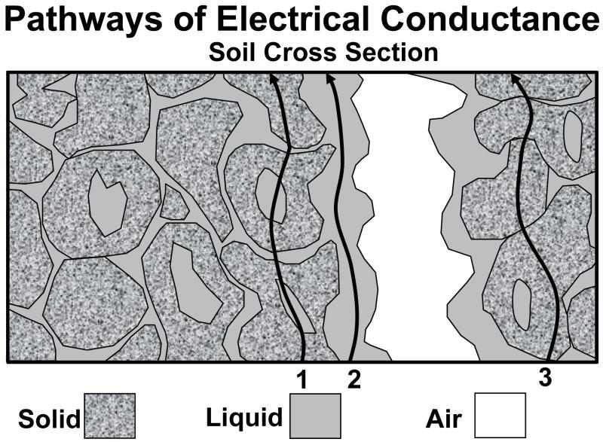
Background
Electrical resistivity of soil is closely related to
Solid nature: mineralogy, shape, fabric, size distribution
Void arrangement: porosity, crack, tortuosity, pore structure
Fluid property: water content, solute concentration

Slide 7
Outline
Problem Statement and Background
Study Objectives
Study Benefits
Research Plan
Research Progress
Project Timeline
References

Slide 8
Research Goal
Goal: Develop a rapid, noninvasive, three-dimensional permafrost assessment and mapping system that provides soil profiles and characterization of soil properties.
Initial evaluations will be based on Time Domain Electromagnetic Induction (TD EMI) and related techniques building on the results obtained from the CRREL iFROST mapping system.

Slide 9
Objectives
Identify and measure major influence factors
Determine the correlation between electrical resistivity and other soil properties
Develop a truck-mounted EMI system
Investigate the field performance of the truck-mounted EMI compared with ground truth survey results
Modify the portable EMI system to improve performance
Provide guidelines and specifications on the suitability of the EMI system
Submit a final report

Slide 10
Outline
Problem Statement and Background
Study Objectives
Study Benefits
Research Plan
Research Progress
Project Timeline
References

Slide 11
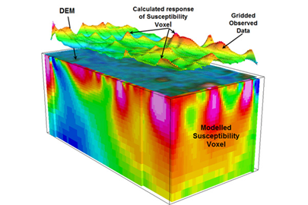
Study Benefits
Rapid and noninvasive permafrost soil characterization in cold regions
3D geographical and geotechnical subsurface profiles
Quality control of pavement construction
Shorten the time needed for site investigation and speed up the construction of vital infrastructure in cold regions
Typical applications: permafrost mapping, levee and dam assessment, slope stability assessment, landfill characterization, runway remediation, ground surface structural competency evaluation.

Slide 12
Outline
Problem Statement and Background
Study Objectives
Study Benefits
Research Plan
Research Progress
Project Timeline
References

Slide 13
Research Plan
Task 1
Conduct a comprehensive literature review (70%)
Task 2
Prepare and execute a laboratory testing plan (30%)
Task 3
Develop a truck-mounted permafrost characterization system (20%)

Slide 14
Research Plan
Task 4
Conduct full-scale electrical resistivity surveying of permafrost at CREATEs (0%)
Task 5
Evaluate field performance of the permafrost characterization system (0%)
Task 6
Prepare final report and recommendations (0%)

Slide 15
Outline
Problem Statement and Background
Study Objectives
Study Benefits
Research Plan
Research Progress – Task 1
Project Timeline
References

Slide 16
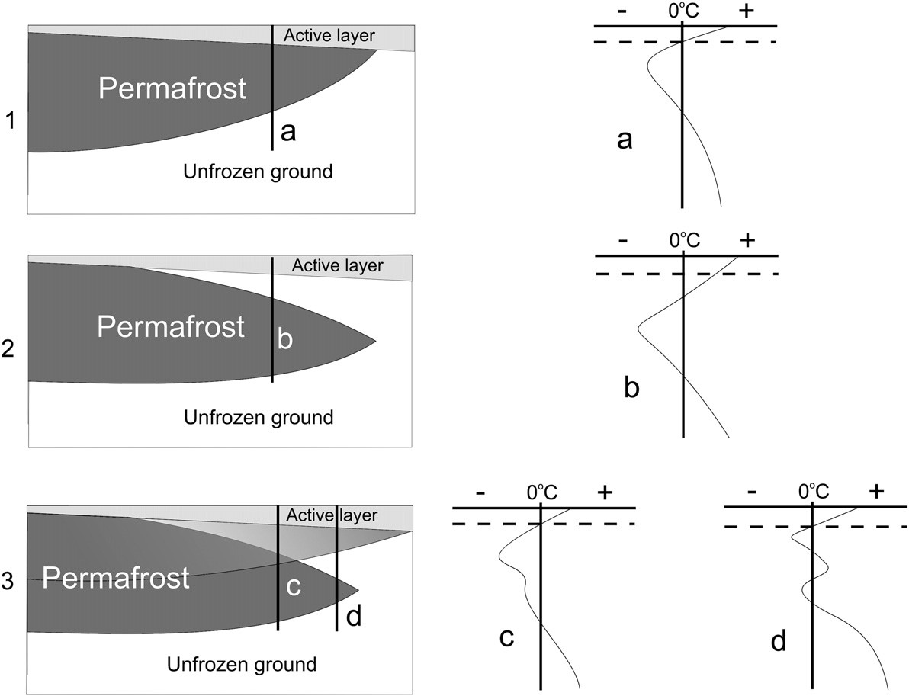
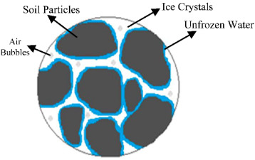
Task 1 Literature Review 1.1 Permafrost
4-phase distribution in frozen soil (Kadivar & Manahiloh, 2019)
Distribution of permafrost in subsurface: indication from temperature testing, where active layer represents seasonal permafrost (Dobinski, 2011)

Slide 17
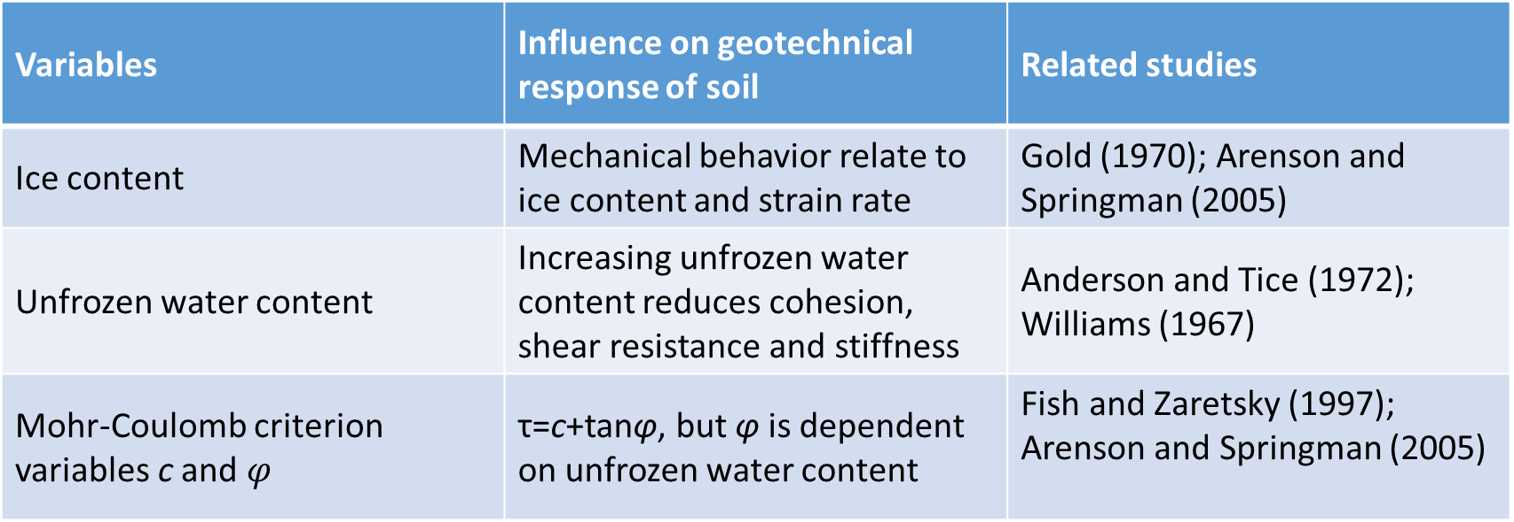
Task 1 Literature Review 1.1 Permafrost Properties
Variables | Influence on geotechnical response of soil | Related studies
Ice content | Mechanical behavior relate to ice content and strain rate | Gold (1970); Arenson and Springman (2005)
Unfrozen water content | Increasing unfrozen water content reduces cohesion, shear resistance and stiffness | Anderson and Tice (1972); Williams (1967)
Mohr-Coulomb criterion variables c and $φ$ | τ=c+tanφ, but φ is dependent on unfrozen water content | Fish and Zaretsky (1997); Arenson and Springman (2005)

Slide 18
Task 1 Literature Review 1.2 Electrical Resistivity Measurement
Electrode-based method
(Florsch and Muhlach, 2018)
(Florsch and Muhlach, 2018)
Depth of detection is influenced by electrode distance.
EMI method
The transmitter produces an magnetic field.
The flow variation produces eddy currents, which themselves create a secondary magnetic field.
(Florsch & Muhlach, 2018)

Slide 19
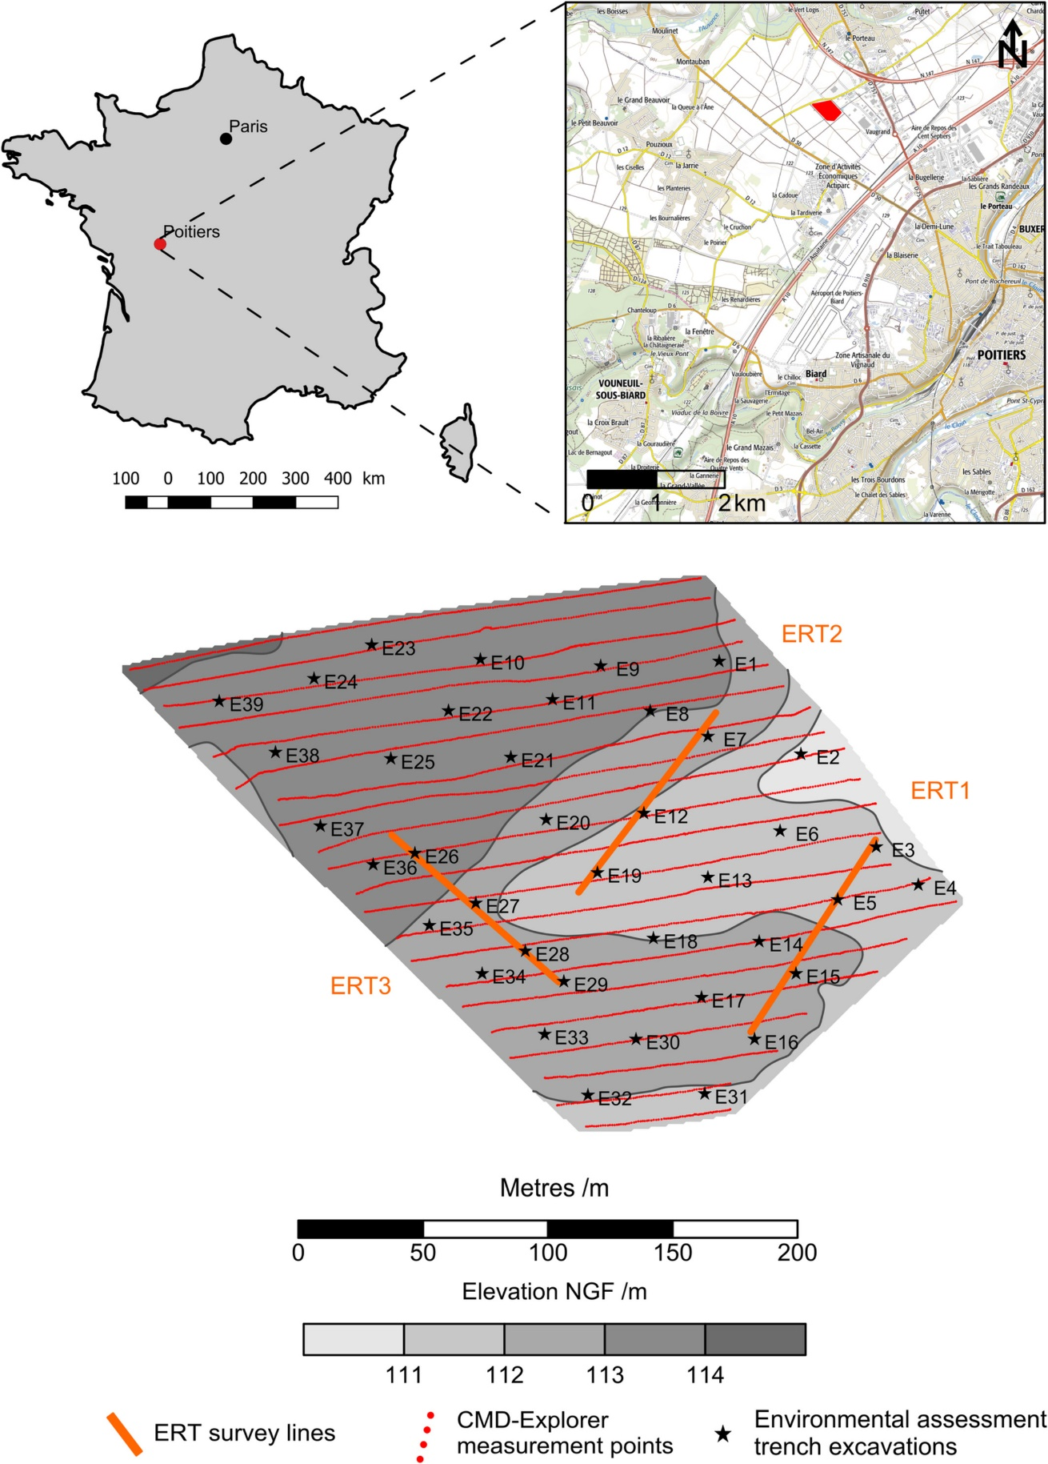
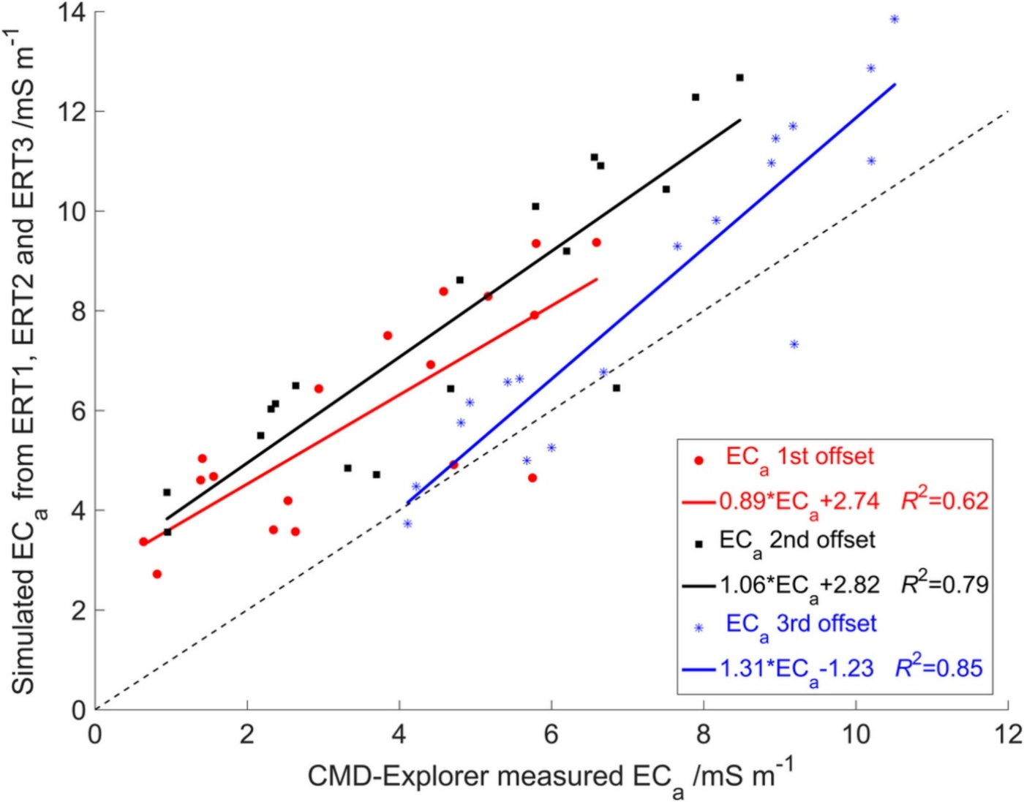
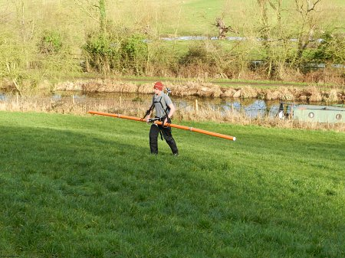
Task 1 Literature Review 1.3 ERT vs EMI
Comparable values from electrode-based resistivity testing (ERT) and electromagnetic induction (EMI - 10kHz)
CMD Explorer from GF Instruments
(Cavalcante Fraga et al., 2019)

Slide 20
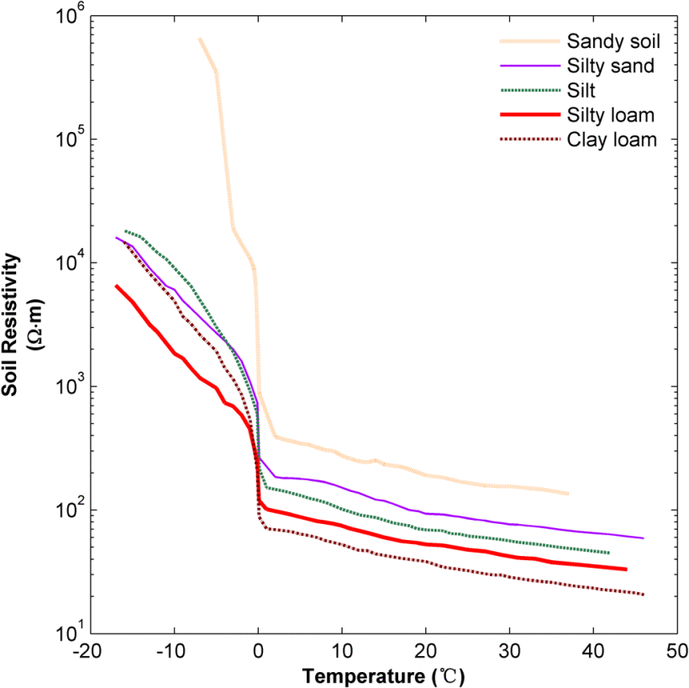
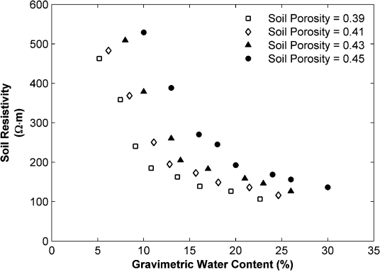
Task 1 Literature Review 1.4 Influencing Factors of ER
Remarkable increase in resistivity at 0 °C
Continuously increasing resistivity when T < 0 °C (Zhou et al., 2015)
Resistivity decreases with increasing water content under room temperature (20 °C).

Slide 21
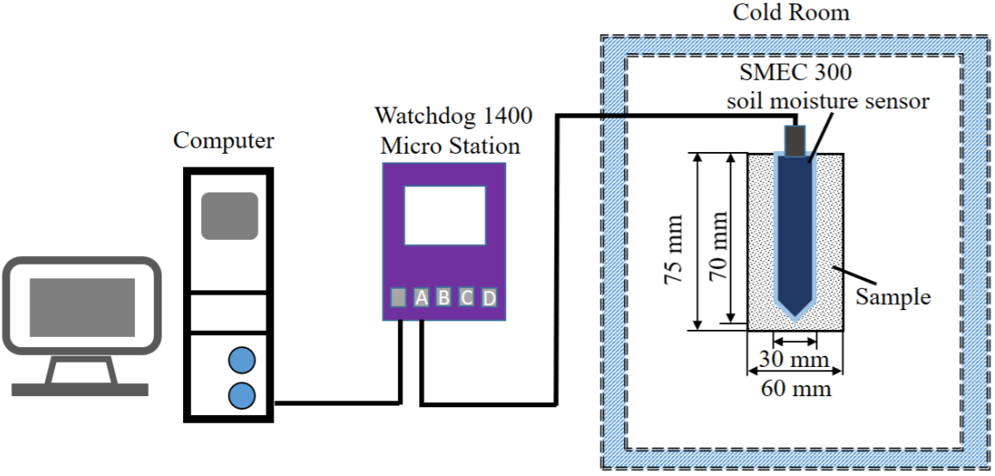
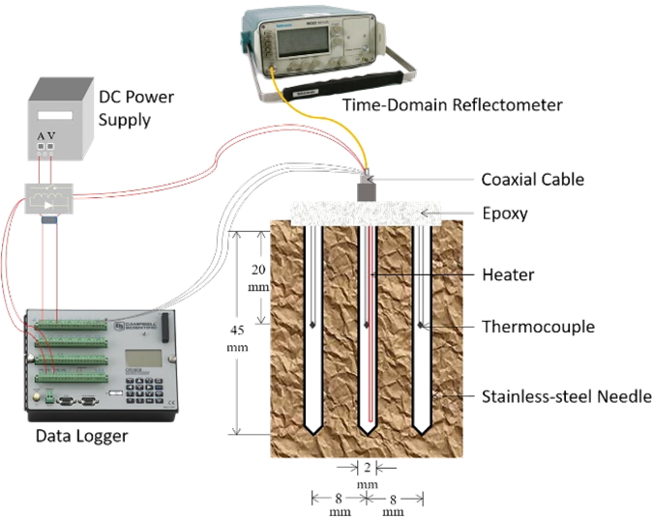
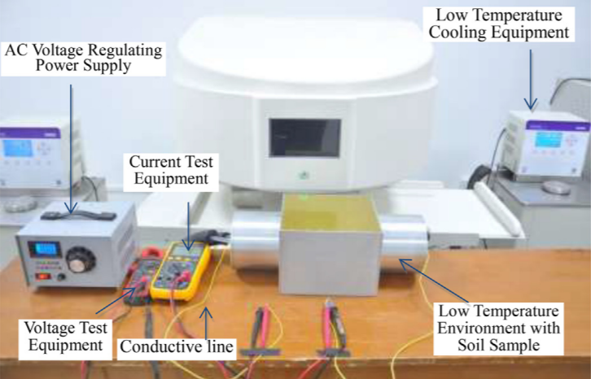
Task 1 Literature Review 1.5 Estimation of Unfrozen Water Content
Capacitance technique
TDR (time-Domain Reflectometry)
Tian et al. (2017)
Li et al. (2018)
Mathematical calculation
NMR (Nuclear Magnetic Resonance)
Modified Archie’s Law (Oldenborger and LeBlanc, 2018)
log(ρ₂|_{T2}) − log(ρ₁|_{T1}) + log (b₂/b₁) = (1 − n) log (S₂/S₁)
where
ρ electrical resistivity
T temperature
b [1 + a (T − 25)] / [1 − 25a], a = 0.0187
n saturation exponent (determined by Glover (2017))
S degree of saturation
Tang et al. (2018)

Slide 22
Outline
Problem Statement and Background
Study Objectives
Study Benefits
Research Plan
Research Progress – Task 2
Project Timeline
References

Slide 23
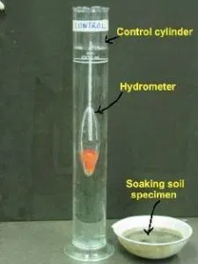
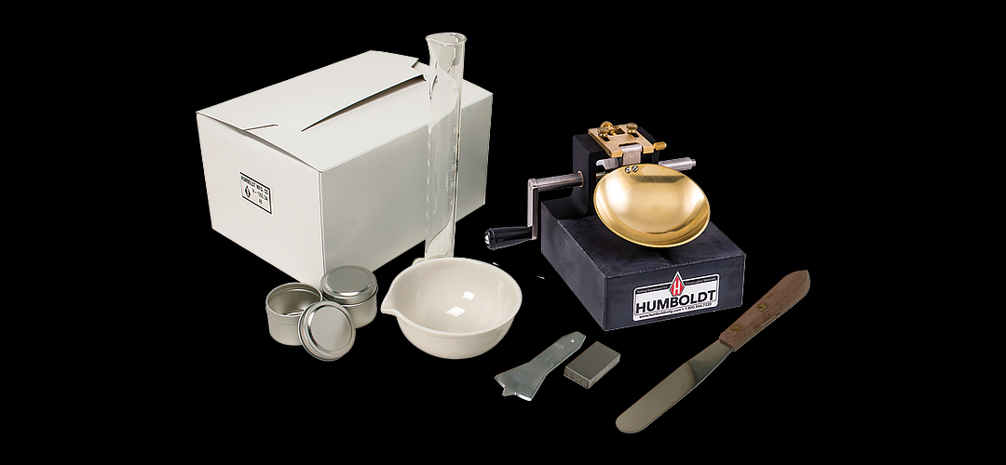
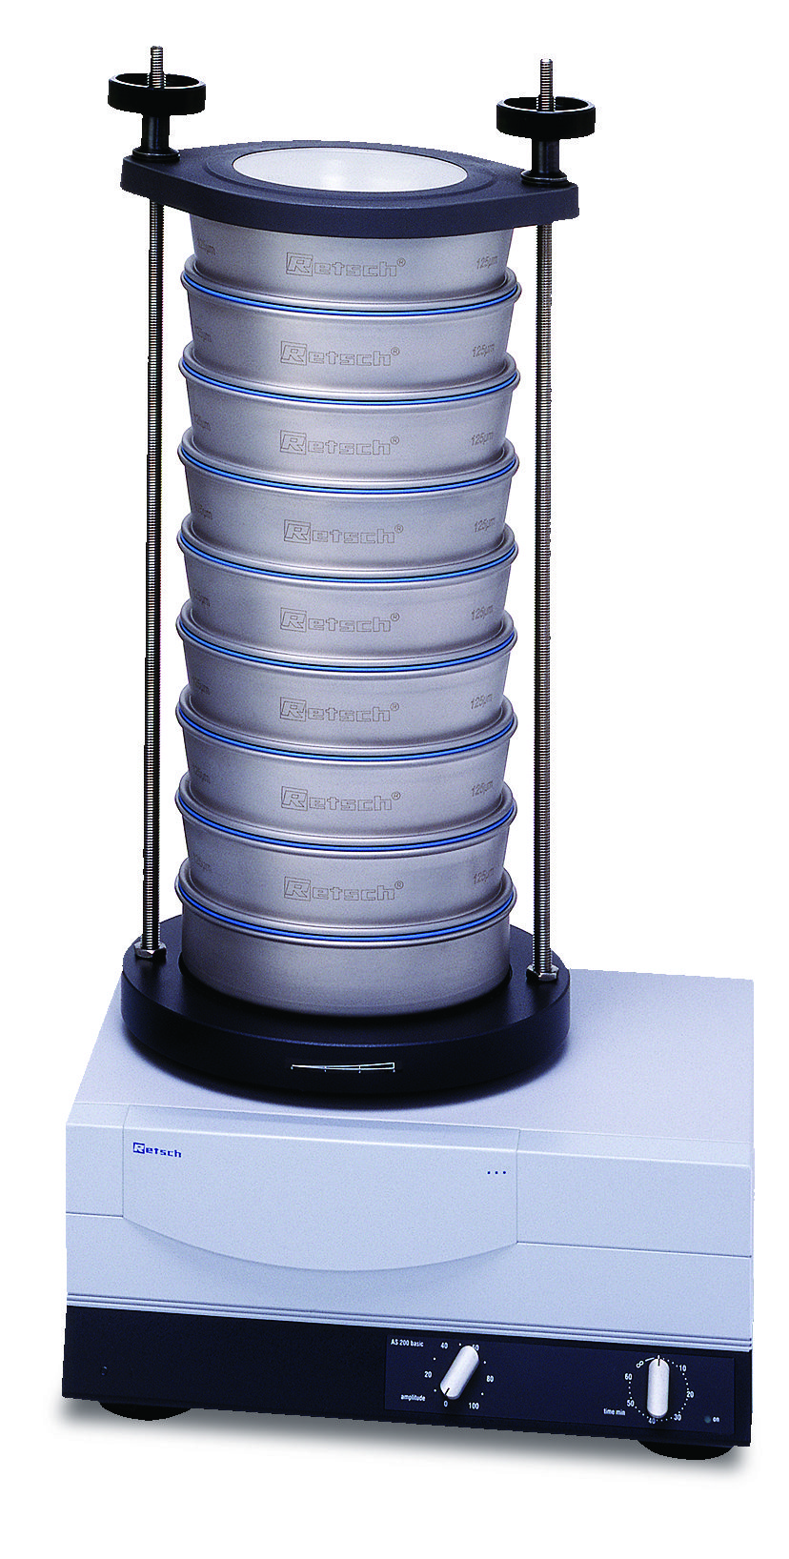
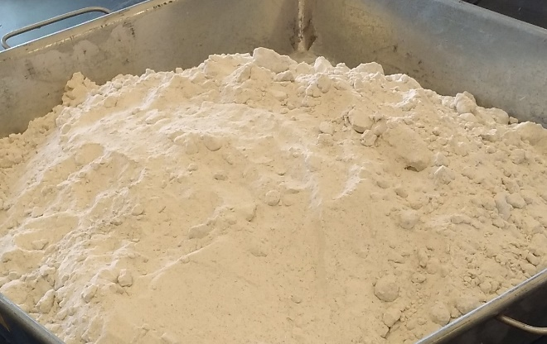
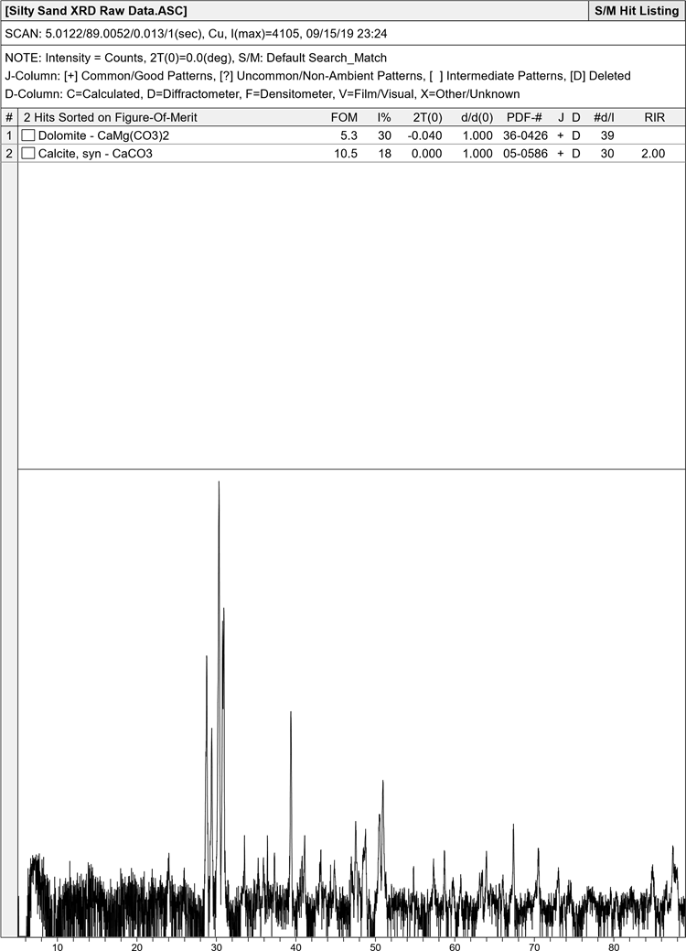
Task 2 Experimental Study 2.1 Soil Property Tests – Flowchart
Atterberg Limit
Hydrometer
Soil samples
Sieve analysis
X-ray diffraction (XRD)

Slide 24
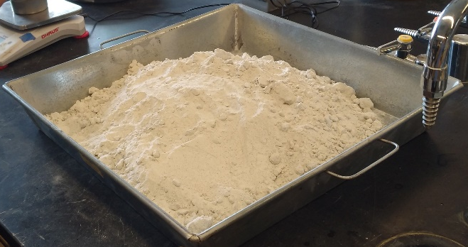
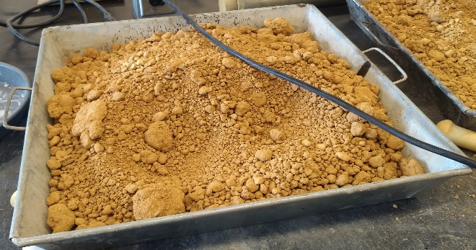
Task 2 Experimental Study 2.1 Soil Property Tests – Grain Size Analysis
Silty sand (Pond Fill Soil)
Clayey sand (Jem Paving Soil)
Sand | 34.76%
Silt | 63.85%
Clay | 1.39%
Sand | 63.32%
Silt | 16.61%
Clay | 19.67%

Slide 25


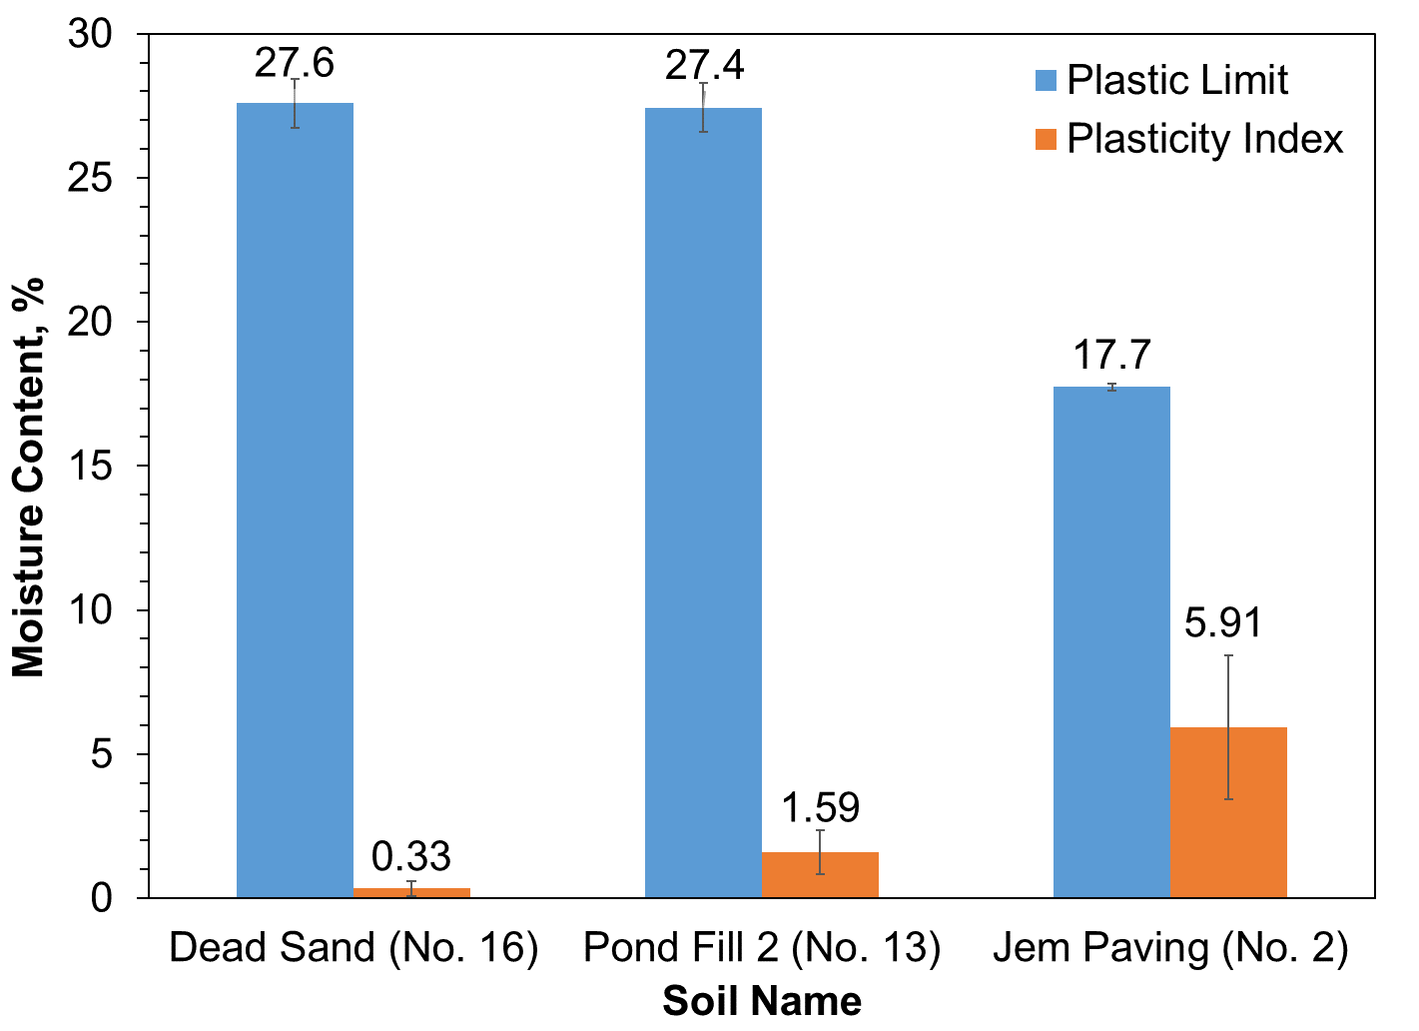
Task 2 Experimental Study 2.1 Soil Property Tests – Atterberg Limit
Silty Sand (Pont Fill)
Liquid limit = 29.02
Plastic limit = 27.47
Clayey Sand (Jem Paving)
Liquid limit = 25.93
Plastic limit = 17.7

Slide 26
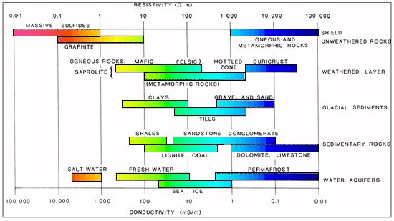
Task 2 Experimental Study 2.1 Soil Property Tests – Soil Mineralogy
Silty sand
Dolomite (CaMg(CO₃)₂)
Calcite (CaCO₃)
Clayey sand
Gismondine (one of igneous rocks)
Quartz (SiO₂)
(Palacky, 1987)
Clayey sand
Silty sand

Slide 27
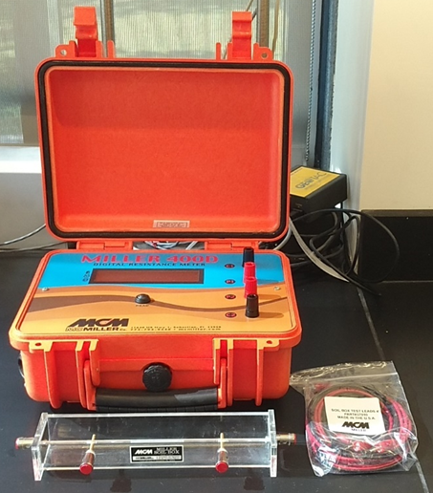
Task 2 Experimental Study 2.2 ER Testing Kit
Resistance meter
Wires
Soil box
[ASTM D6431]

Slide 28
Task 2 Experimental Study 2.2 ER Measurement using Miller Soil Box
ER decreases with higher water content.
Influence of water content on ER reduces when soil reaches 100% saturation.
Higher salt concentration reduces ER significantly.

Slide 29
Task 2 Experimental Study 2.2 Electrical Conductivity of Soil Solutions
Electrical conductivity test in soil slurry
Method: ASTM D4972 - 19
Soil solid-to-water ratio: 1:1
Mix slurry and settle for 1 h
Silty sand showed higher electrical conductivity, indicating the existence of soluble salts.

Slide 30
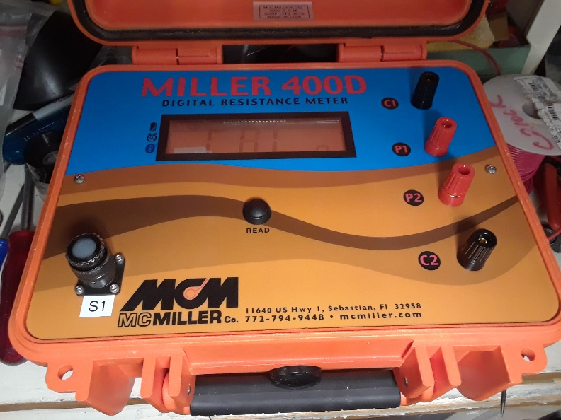
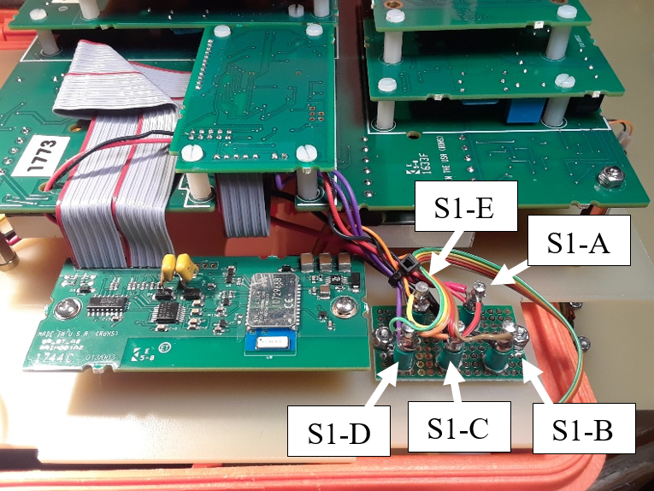
Task 2 Experimental Study 2.3 Modifications to ER Testing Kit
Min-spec connector S1 mounted to faceplate
Functions of pinouts of S1
Pin | Internal Function
A | +Battery Terminal +Vin Input to Board
B | Common Input to Board
C | -Battery Terminal
D | Front Panel READ Switch
E | Front Panel READ Switch

Slide 31
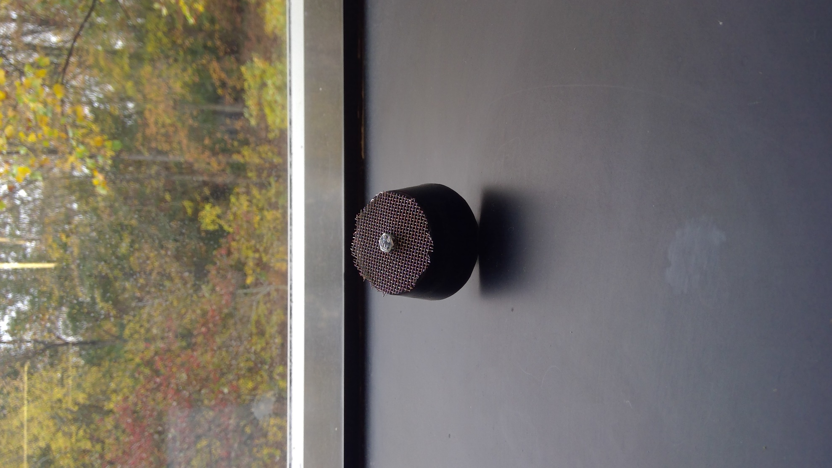
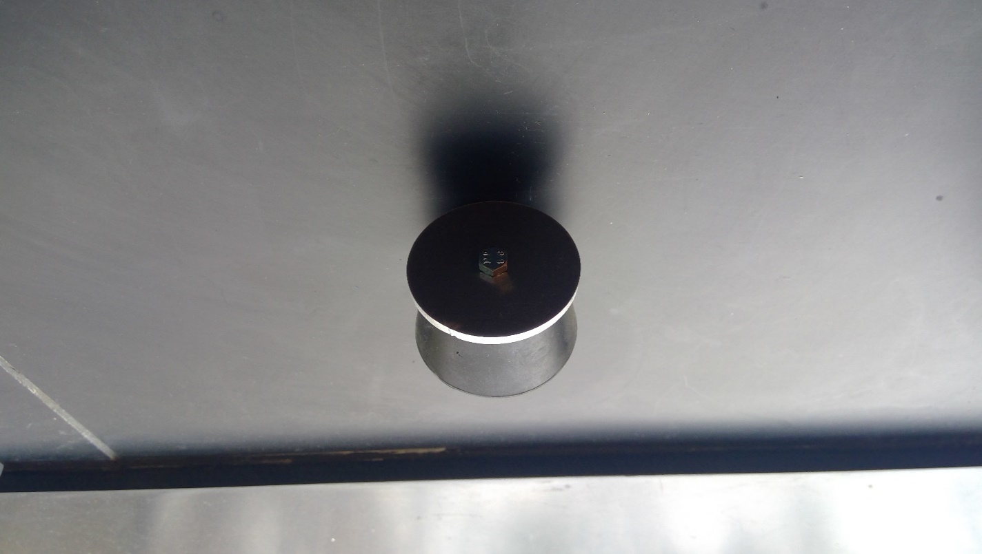
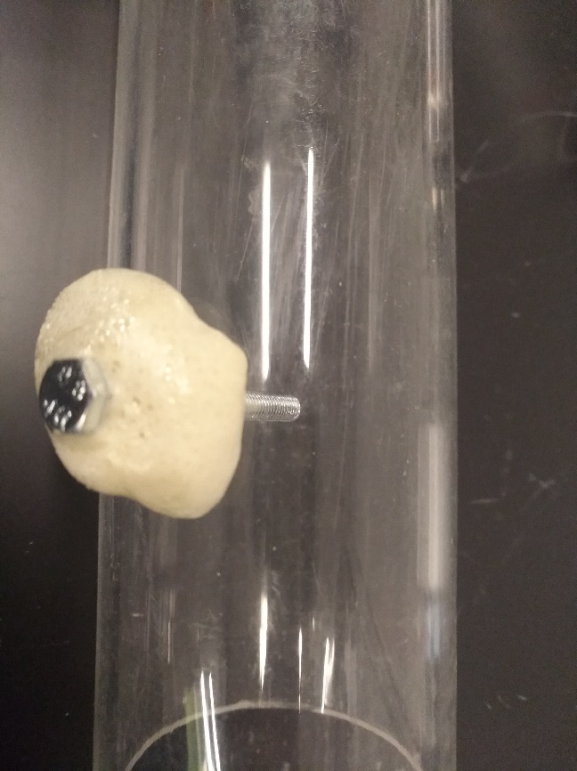
Task 2 Experimental Study 2.4 Design of Cylindrical Soil Holder
Use foam sealant to prevent leaking at gaps
Compact soil homogenously with identical layers
Make panel-like electrodes to make good connectivity between soil and electrodes at top and bottom
Cylindrical soil holder
Steel mesh
Electrode
Rubber stopper
Aluminum mesh
Aluminum panel
A screw functioning as electrode, with water sealant
Electrode

Slide 32
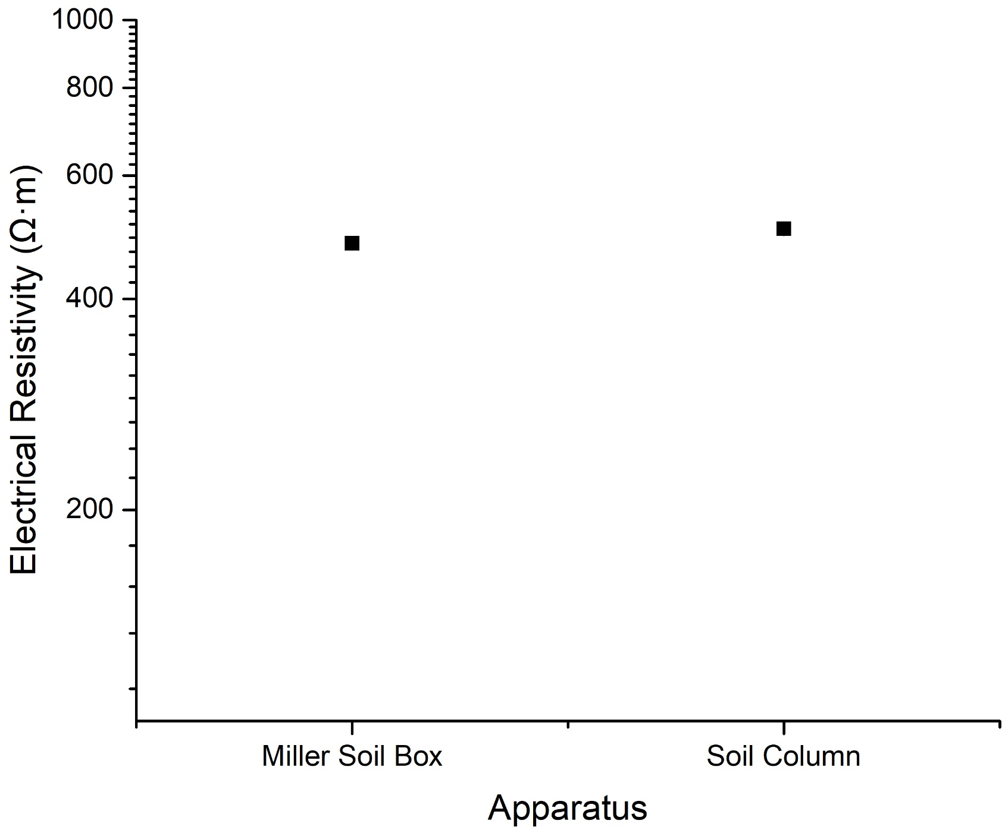
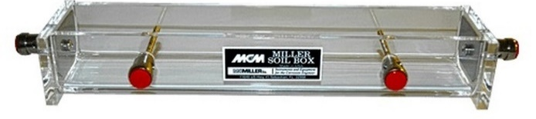
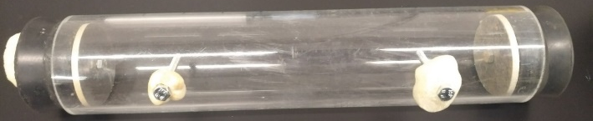
Task 2 Experimental Study 2.5 Validation of Cylindrical Soil Holder
Clayey sand,
water content = 10%

Slide 33

Task 2 Experimental Study 2.5 Influence of $ρ$ and W on ER
ER decreases with higher water content.
ER decreases with higher density.
The influence of water content on ER is much stronger than that of density.

Slide 34



Task 2 Experimental Study 2.6 Frozen Soil Testing Configuration
Note: electrical resistivity and temperature testing can be done continuously.
Connect to PC via Bluetooth
Soil column for ER
Resistivity
Soil column for temperature
Data logger
PC for data recording
Wi-Fi modem
Connect to PC via Wi-Fi
Environmental chamber

Slide 35
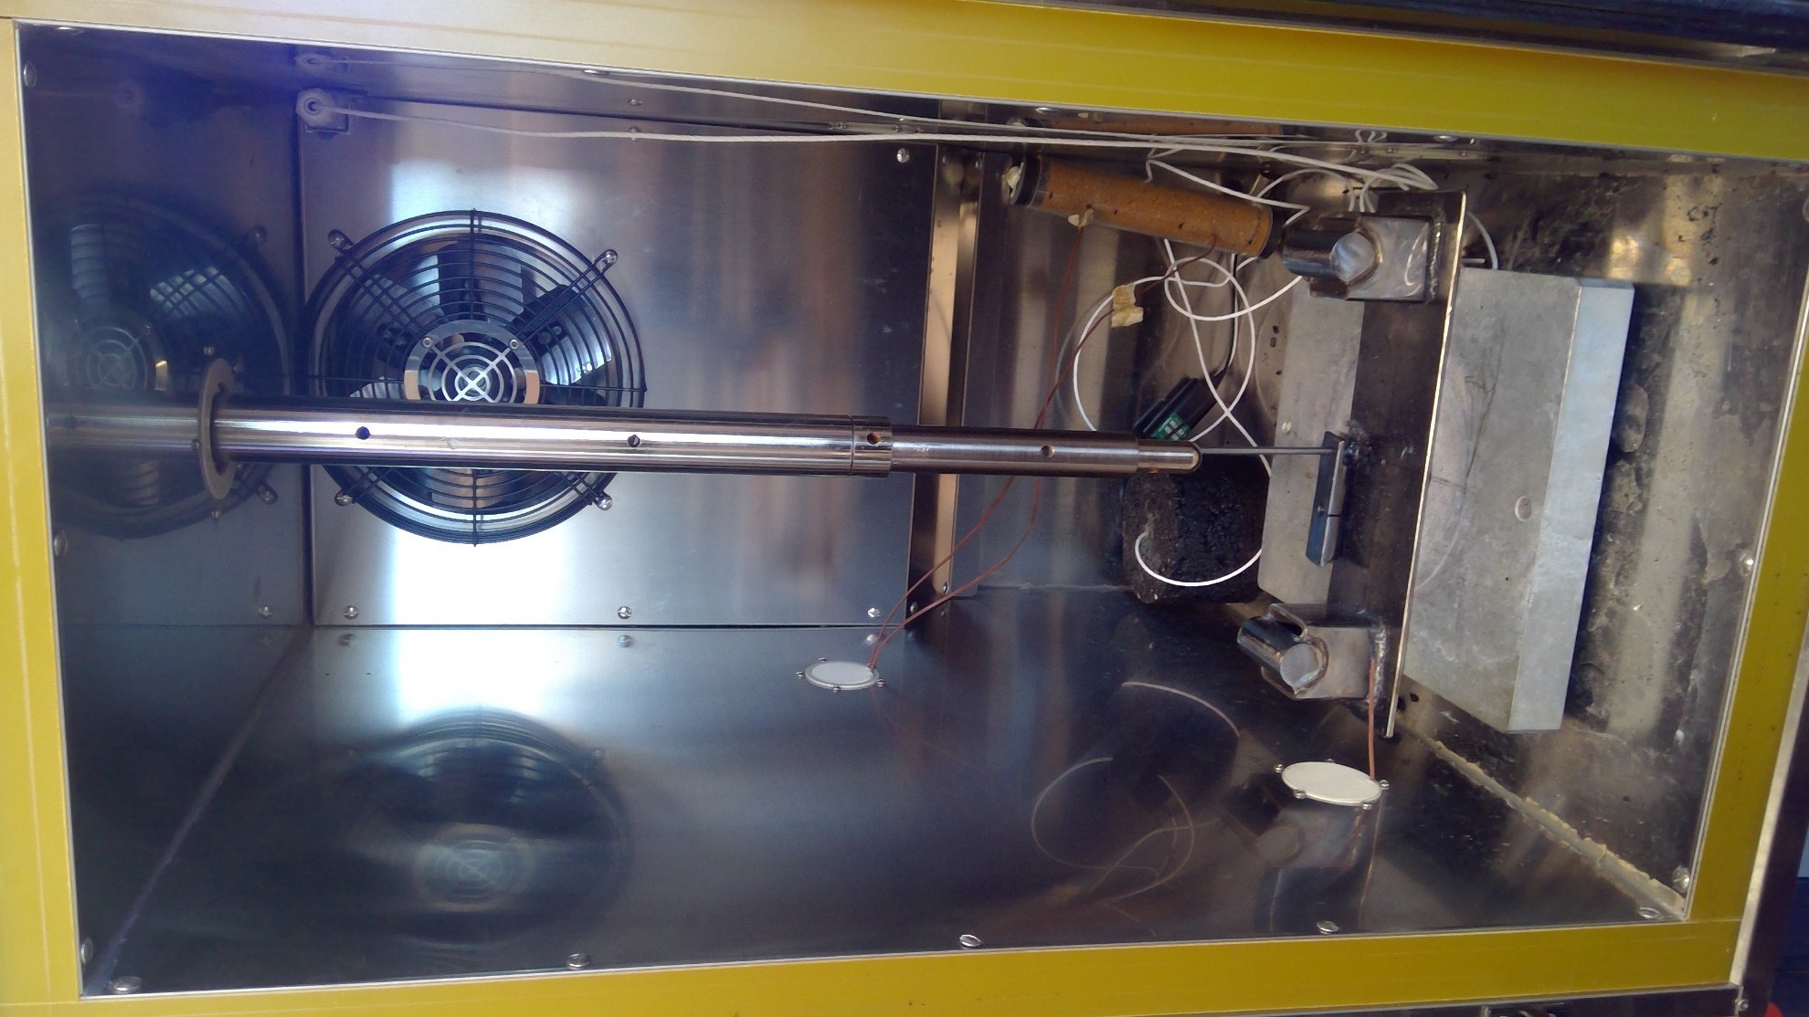
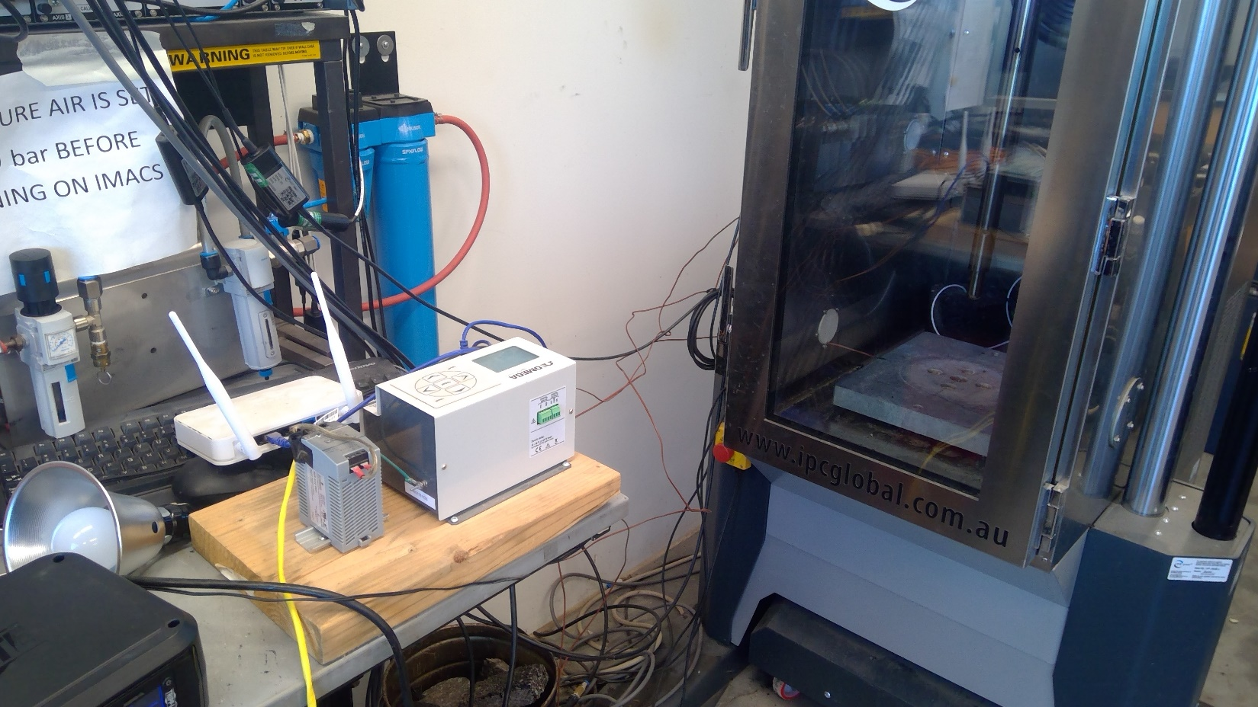
Task 2 Experimental Study 2.7 Temperature Evolution (one soil column)
Integrate environmental chamber and thermal couples
Three points for temperature testing: inside soil column (T1, T2); within the chamber (Q1)
Data logger
Connecting soil column
Note: Further calibration is needed.

Slide 36
Task 2 Experimental Study 2.7 Temperature Evolution (two soil columns)
S = 20%, soil freezes faster.
S = 80%, phase change transition is more evident.
Moist soil requires high energy input to further freeze.

Slide 37
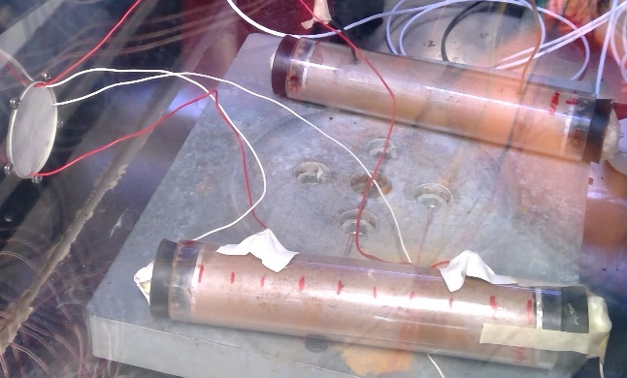
Task 2 Experimental Study 2.8 Temperature and ER Evolutions
ER increases with the decreasing temperature following a non-linear trend.
The evolution of ER at extremely low temperature (T < -20°C) requires further investigations.

Slide 38
Task 2 Experimental Study 2.9 Next Step
Primary factors
Saturation (water content)
Secondary factors
Soil mineralogy
Density
Temperature
Time and rate of freezing
Soil particle size distribution
Pore fluid composition

Slide 39
Task 2 Experimental Study 2.9 Next Step
Sample preparation matrix:
*Number of replicates n = 3 (COV < 10%)
Test Set | Water Content | Bulk density (g/cm³)
1 | 6.5% (20% saturation) | 1.65
2 | 7.5% | 1.75
3 | 11% | 1.85
4 | 15% | 1.75
5 | 16.5% | 1.65
6 | 20% | 1.65, 1.45, 1.25
7 | 23% | 1.45, 1.25
8 | 26% (80% saturation) | 1.45, 1.25
Standard compaction curve of Clayey Sand
Thermal paths:
Temperature decreases from room temperature to -40°C,
Temperature is maintained at low temperature levels (-20°C, -40°C).
Temperature increases to room temperature after freezing.

Slide 40
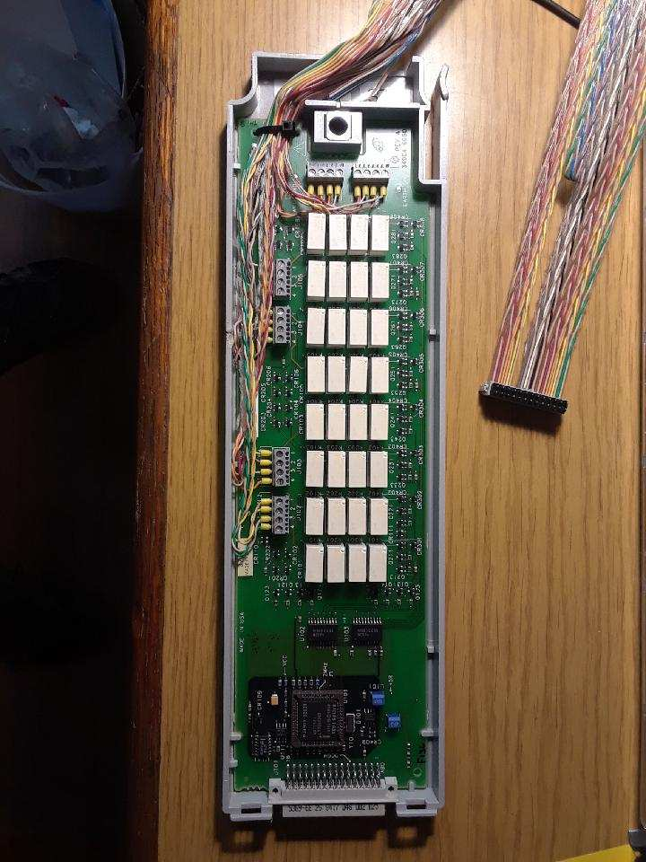
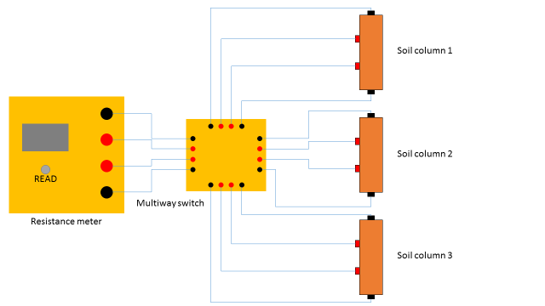
Task 2 Experimental Study 2.9 Next Step

Slide 41
Task 2 Experimental Study 2.9 Next Step
Two boxes with identical settings of soil structure
Correlate ER results between EMI and ERT
Research factors
Formation of ice structure
Freeze-thaw cycle
Homogeneous or partial freezing
Arrays of electrodes for mapping
HFEMI device
Electrodes on side walls
Electrical resistivity
Electromagnetic induction

Slide 42
Outline
Problem Statement and Background
Study Objectives
Study Benefits
Research Plan
Research Progress – Task 3
Project Timeline
References

Slide 43
Task 3 EMI Development
The iFrost system consists of a transmitter and receiver coil to send and receive electromagnetic signals to and from the soil.
When the transmitter sends a primary field to the soil, any conductive body within range of the primary field will generate eddy currents in response to the signal.
This creates a secondary field that the receiver must read and filter out of the primary field.
The measured secondary field directly corresponds to the conductivity of the object below the soil.

Slide 44
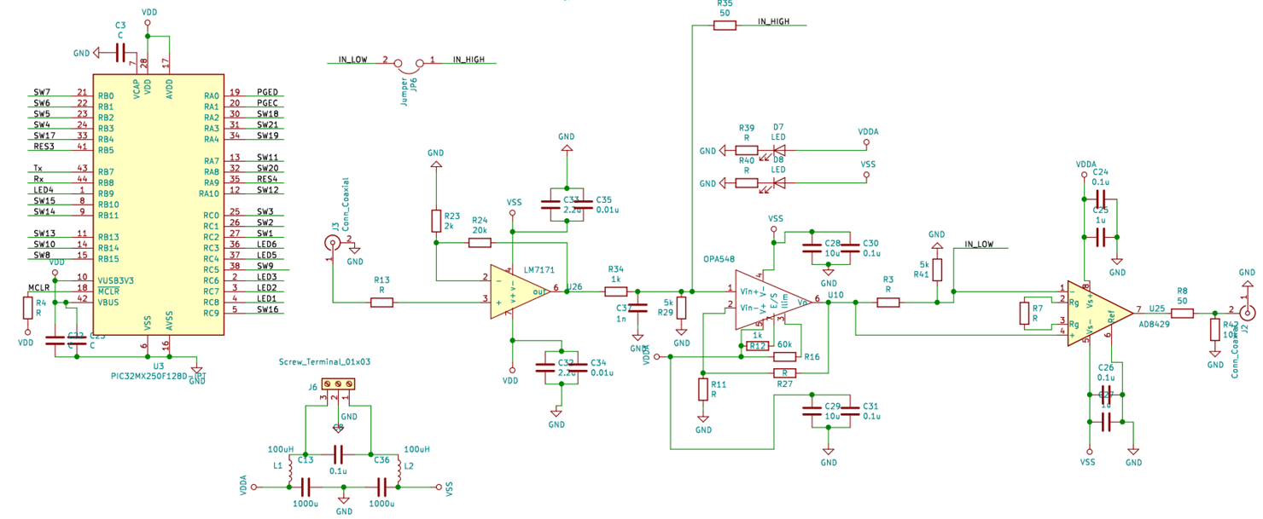
Task 3 EMI Development
Transmitter Schematic
Courtesy of CRREL

Slide 45
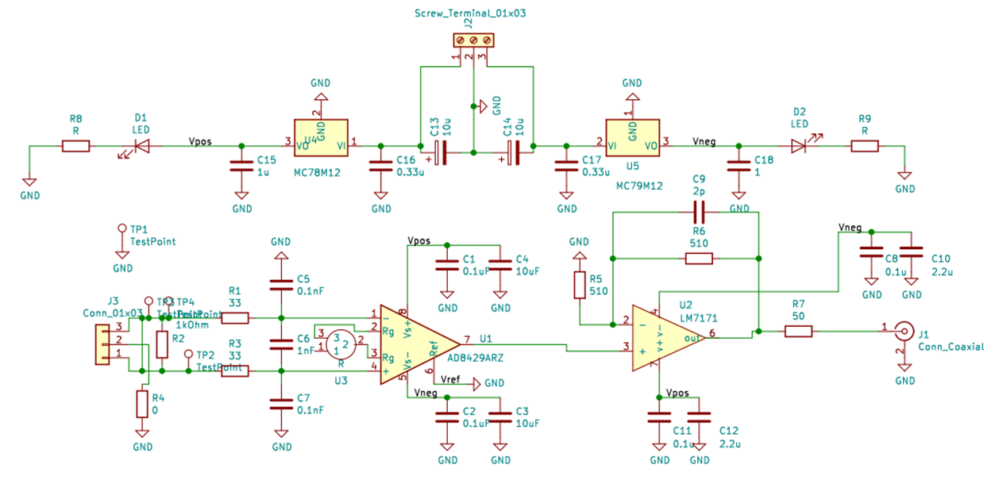
Task 3 EMI Development
Receiver Schematic
Courtesy of CRREL

Slide 46
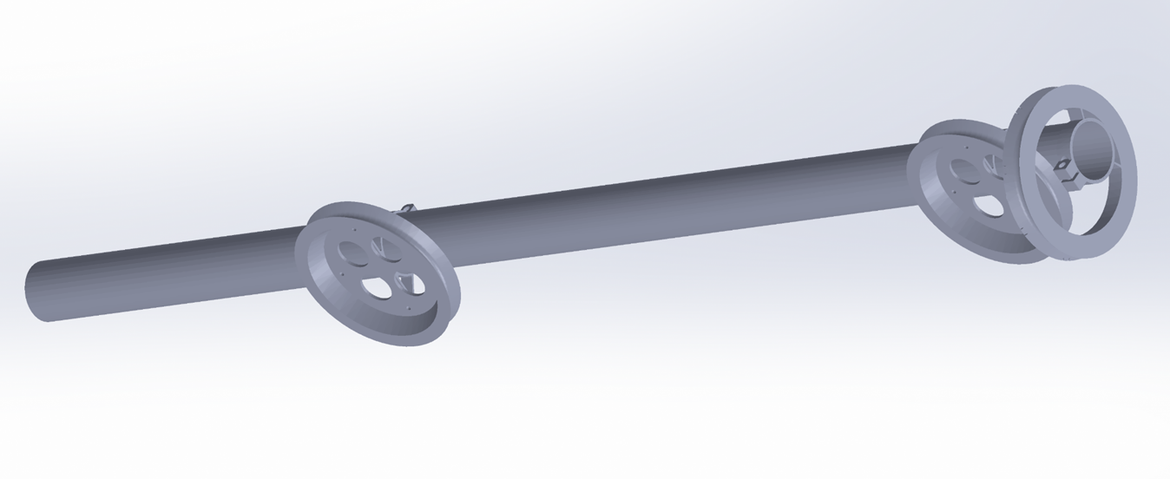
Task 3 EMI Development
Receiver Boom
Courtesy of CRREL

Slide 47
Task 3 EMI Development
Research Progress:
Constructed a transmitter coil and began testing its properties
3D printed a receiver coil form
Began development of a filter system using a lock-in amplifier
Advanced the CEE group’s measurement procedures by designing and building a 7.5 V power supply for the Miller 400D resistance meter

Slide 48
Task 3 EMI Development
Future Work:
Design an accurate filtering system for the receiver using a lock-in amplifier
Finish construction of the receiver
Determine optimal method for switching between capacitors on the transmitter circuit in order to allow for a wide variety of frequencies to be used

Slide 49
Outline
Problem Statement and Background
Study Objectives
Study Benefits
Research Plan
Research Progress
Project Timeline
References

Slide 50
Project Timeline
Task No. | 2019 |  |  |  |  |  | 2020 |  |  |  |  |  |  |  |  |  |  |  | 2021
 | 7 | 8 | 9 | 10 | 11 | 12 | 1 | 2 | 3 | 4 | 5 | 6 | 7 | 8 | 9 | 10 | 11 | 12 | 1 | 2 | 3 | 4 | 5 | 6
1 Literature review
2 Lab test
3 Ifrost Mapper
4
5
6
Develop proposal opportunities including NSF: Navigating the New Arctic

Slide 51
References
Dobinski, Wojciech. “Permafrost.” Earth-Science Reviews, vol. 108, no. 3-4, Oct. 2011, pp. 158–169., doi:10.1016/j.earscirev.2011.06.007.
Kadivar, M. and K. N. Manahiloh (2019). "Revisiting parameters that dictate the mechanical behavior of frozen soils." Cold Regions Science and Technology 163: 34-43.
Zhou, M., J. G. Wang, L. Cai, Y. D. Fan and Z. N. Zheng (2015). "Laboratory Investigations on Factors Affecting Soil Electrical Resistivity and the Measurement." Ieee Transactions on Industry Applications 51(6): 5358-5365.
Florsch, N., & Muhlach, F. d. r. (2018). Everyday applied geophysics. London, UK; Oxford, UK: ISTE Press; Elsevier.
You, Y., Yu, Q., Pan, X., Wang, X. and Guo, L., 2013. Application of electrical resistivity tomography in investigating depth of permafrost base and permafrost structure in Tibetan Plateau. Cold Regions Science and Technology, 87, pp.19-26.
Tian, Z. C., Ren, T. S., Kojima, Y., Lu, Y. L., Horton, R., and Heitman, J. L., 2017, An improved thermo-time domain reflectometry method for determination of ice contents in partially frozen soils: Journal of Hydrology, v. 555, p. 786-796.
Oldenborger, G. A., and LeBlanc, A. M., 2018, Monitoring changes in unfrozen water content with electrical resistivity surveys in cold continuous permafrost: Geophysical Journal International, v. 215, no. 2, p. 965-977.
Glover, P. W. J. (2017). "A new theoretical interpretation of Archie's saturation exponent." Solid Earth, 8(4), 805-816.
Cavalcante Fraga, L. H., Schamper, C., Noël, C., Guérin, R., and Rejiba, F., 2019, Geometrical characterization of urban fill by integrating the multi-receiver electromagnetic induction method and electrical resistivity tomography: A case study in Poitiers, France: European Journal of Soil Science, v. 70, no. 5, p. 1012-1024.
Kouchaki, B. M., Bernhardt-Barry, M. L., Wood, C. M., and Moody, T. (2019). "A Laboratory Investigation of Factors Influencing the Electrical Resistivity of Different Soil Types." Geotech Test J, 42(4), 829-853.
Palacky, G.V. (1987), Resistivity characteristics of geologic targets, in Electromagnetic Methods in Applied Geophysics, Vol 1, Theory, 1351

Slide 52
References (continued)
Gold LW: Process of failure in ice. Canadian Geotechnical Journal 7 (1970) 405-413.
Arenson LU and Springman SM: Triaxial constant stress and constant strain rate tests on icerich permafrost samples. Canadian Geotechnical Journal 42 (2005a) 412-430.
Anderson DM and Tice AR: Predicting unfrozen water content in frozen soils from surface area measurements, Highway Research Record (1972).
Williams PJ: Unfrozen water content of frozen soils and soil moisture suction. Publications of the Norwegian Geotechnical Institute 72 (1967) 11-26.
Arenson LU and Springman SM: Mathematical description for the behaviour of ice-rich frozen soils at temperatures close to zero centigrade. Canadian Geotechnical Journal 42 (2005b) 431-442.
Li, Haipeng, Zhaohui Joey Yang, and Jiahui Wang. "Unfrozen water content of permafrost during thawing by the capacitance technique." Cold Regions Science and Technology 152 (2018): 15-22.
Patterson, D. E., and M. W. Smith. "Unfrozen water content in saline soils: results using time-domain reflectometry." Canadian Geotechnical Journal 22.1 (1985): 95-101.
Tang, Liyun, et al. "A resistivity model for testing unfrozen water content of frozen soil." Cold Regions Science and Technology 153 (2018): 55-63.
Zhang, Mingyi, et al. "Experimental and numerical analyses of the thermo-mechanical stability of an embankment with shady and sunny slopes in a permafrost region." Applied Thermal Engineering 127 (2017): 1478-1487.
Anderson, Duwayne M., and Allen R. Tice. "Predicting unfrozen water contents in frozen soils from surface area measurements." Highway research record 393 (1972): 12-18.
Michalowski, Radoslaw L. "A constitutive model of saturated soils for frost heave simulations." Cold regions science and technology 22.1 (1993): 47-63.

Slide 53
Thank You!

Slide 54
Appendix

Slide 55
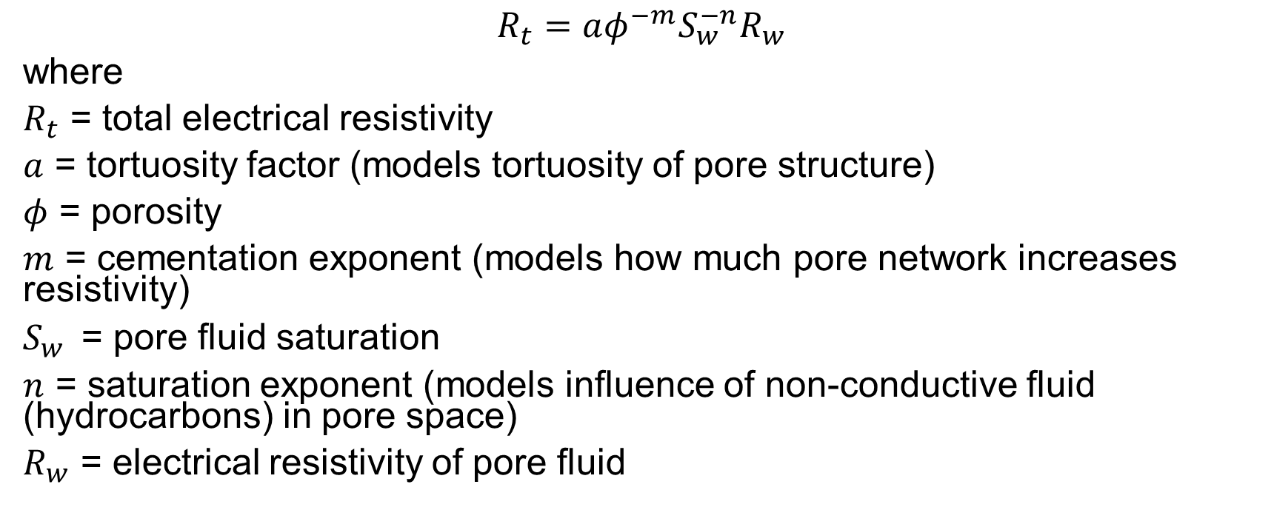
A brief introduction to Archie’s law
$$R_{t}=aφ^{−m}S_{w}^{−n}R_{w}$$
where
$R_{t}$ = total electrical resistivity
$a$ = tortuosity factor (models tortuosity of pore structure)
$φ$ = porosity
$m$ = cementation exponent (models how much pore network increases resistivity)
$S_{w}^{}$ = pore fluid saturation
$n$ = saturation exponent (models influence of non-conductive fluid (hydrocarbons) in pore space)
$R_{w}$ = electrical resistivity of pore fluid

Slide 56
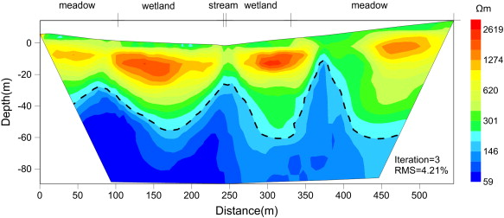
Possible application of geophysical method in cold regions
Electrical resistivity tomography (ERT) of a geological profile of frozen soil
Permafrost soils are concentrated at shallow subsurface
Black dash line marks border between frozen/unfrozen soil, obtained by data of borehole temperature testing
(You et al., 2013)

Slide 57
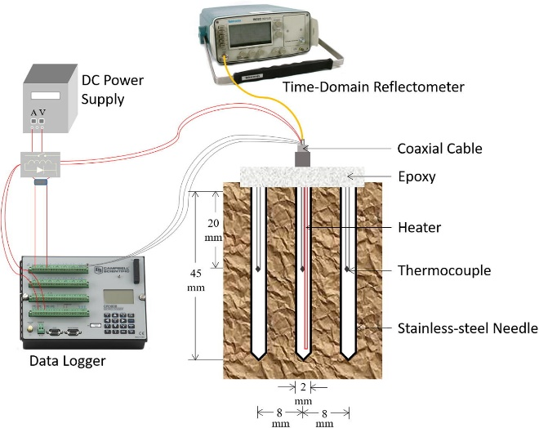
Unfrozen water content: experimental methods
Thermo-TDR probes can measure thermal properties and unfrozen water content simultaneously
This method may have large errors when temperature is close to 0°C and soil has large amount of clay
TDR needle, thermocouple, and heater are attached together
Apparatus needs calibration
(Tian et al., 2017)

Slide 58
Estimating unfrozen water content: calculation methods
Modified Archie’s Law (Oldenborger and LeBlanc, 2018)
log(ρ₂|_{T2}) − log(ρ₁|_{T1}) + log (b₂/b₁) = (1 − n) log (S₂/S₁)
ρ electrical resistivity
T temperature
b [1 + a (T − 25)] / [1 − 25a], a = 0.0187
n saturation exponent (determined by Glover (2017))
S degree of saturation

Slide 59
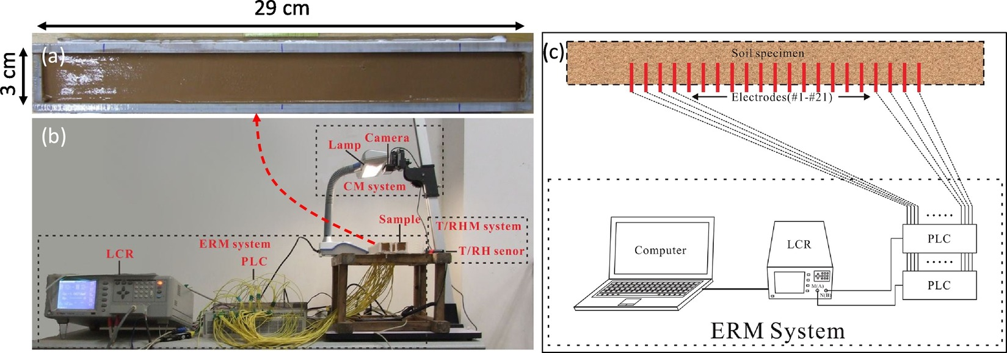
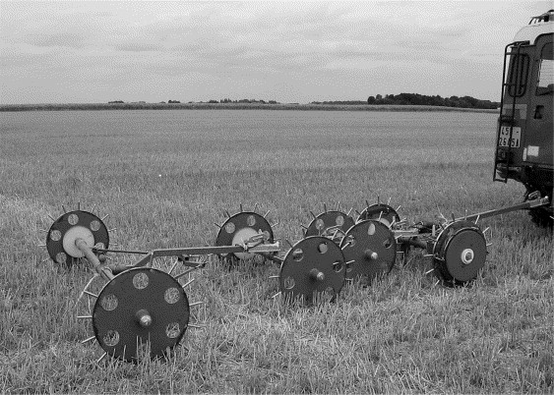
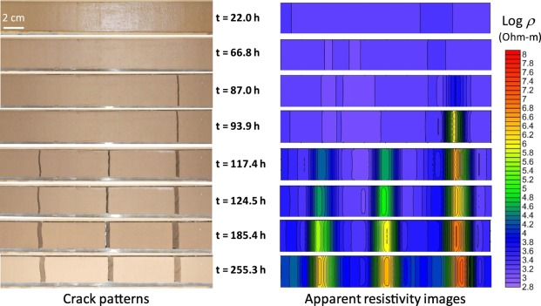
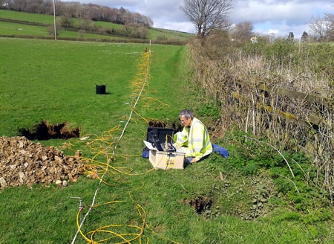
Background

Slide 60
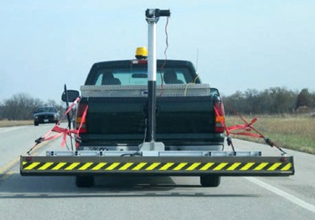


Task 3: Develop Truck-Mounted System
Define/Refine Specifications
Select optimum instrumentation approach
Design/Simulate/α-Prototype and Test
Iterate to β-Prototype
Interaction Design
Integrate PAMS with other systems (Vehicle, GIS, ER, etc.)
Power Supply PCB
FlatSat Prototype

Slide 61




When COTS Isn’t Good Enough
Environmentally ruggedized PAMS
Vibration per MIL-STD-167B
MIL SPEC Temperature, -55°C→+125°C
Packaging
Material, Hermeticity, etc.
Ruggedized Embedded Processor
Thermal Test
Chamber
Unholtz-Dickie Vibe System

Slide 62
Task 3: Test Truck-Mounted System
Test PAMS against specifications
Test the system for the range of environmental conditions expected to be encountered during field applications
Test fused (Consist of) real-time data (ER, geographical information) acquisition, data analysis, and visualization/mapping (GIS) tool.

Slide 63

Task 4: Full Scale Test at CREATEs
Excavate a trench at the testing field of CREATEs
Trench will be thermo-insulated and sealed, before being backfilled with soil of predetermined type and controlled physical properties.
A freezing panel will be applied to the top of the trench in order to lower soil temperature to cold region conditions.

Slide 64


Task 4: Full Scale Test at CREATEs
Tentative plan: 10ft (long) * 5ft (width) * 5ft (depth)
Two scenarios with different known physical properties (e.g., density, water content, pore fluid composition)
3 soil layers
pavement + base + subbase
Temperature and water content sensors will be installed at different depth.
During the construction of each layer, electrical resistivity will be measured using both contact and non-contact methods.

Slide 65
Task 5: Field Evaluation
Carry out field surveying of soil and validate the results against in-situ soil bore log results
Examine the influences of operation condition (e.g., driving speed) and site environment (e.g., temperature, wind, ground surface, light condition) on survey results
Compare with known geotechnical soil profiles obtained from SPT, DCPT, or CPT
2 sites to be chosen inside New Jersey, with known geotechnical investigation data available.

Slide 66
Determining unfrozen water content
Method Used | Pros and Cons | Related Studies
Capacitance technique | Simple and fast testing; Requires calibration process | Li et al. (2018)
TDR (time-Domain Reflectometry) | Simple and fast testing; May be interfered by other factors | Patterson and Smith (1985); West et al. (2007)
NMR (Nuclear Magnetic Resonance) | Accurate testing; High equipment costs | Tang et al. (2018)
Mathematical calculation | No cost in testing; Accuracy depends on models | Zhang et al. (2017a); Anderson and Tice (1972); Michalowski (1993)

Slide 67



Task 5: Field Evaluation
SPT-N values
Penetration Index (DCPI)
Cone resistance, side friction, pore pressure

Slide 68
Task 2 Experimental Study 2.7 Temperature Evolution (two soil columns)
S = 20%, soil freezes faster.
S = 80%, phase change transition is more evident.
Due to the release of heat (exothermic process) during phase change (from water to ice), moist soil requires higher energy input to further freeze.

Slide 69
Task 6: Final Report
Results analysis
Recommendations and further modifications to the system
A draft copy of the final report (three months ahead for review)

